Slide 1
Chiller Error Prediction with Tangle
Notes:
Good Morning, I am Ng Kai Wen from team Tangle, my team mates are Lee Chen Yuan, Markus Ng and Tay Jia Hui, and today we will be presenting on Chiller Error Prediction.

Slide 2
Agenda
Significance of our Findings
Understanding the data
Prepare the data
Build the model
Result
Potential Applications

Slide 3
1.
Significance of Our Findings
How can our error prediction methodology create value for Evercomm?
Notes:
First of all let us discuss the nature of the problem, and the significance of our proposed solution. More specifically, How can our error prediction methodology create value for Evercomm?

Slide 4
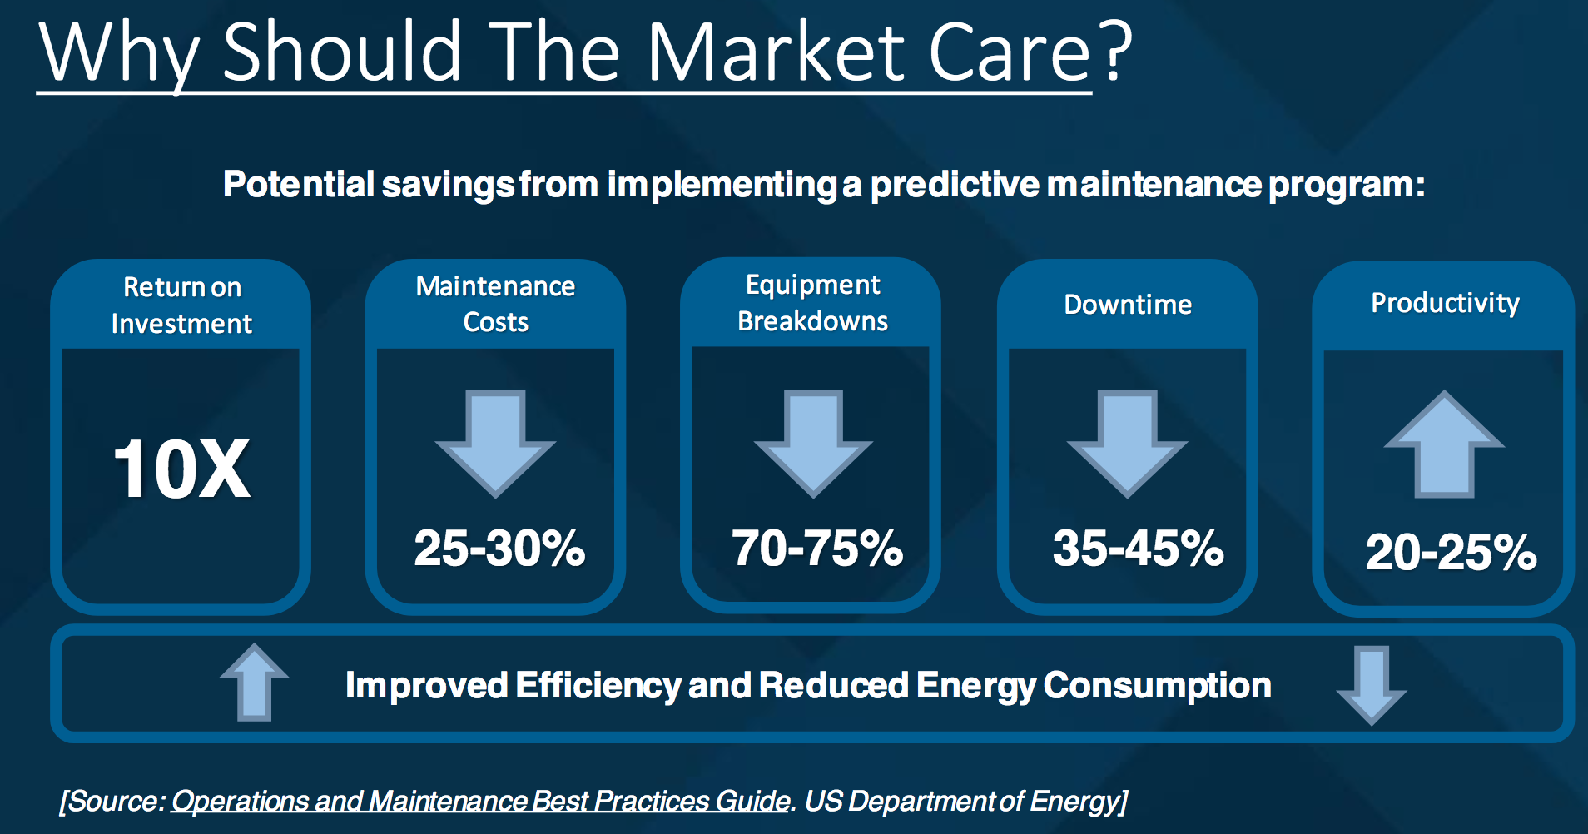
Source: SAS Analytics Experience 2016 presentation on Prediction of Chilled Water Plant Failures and System Optimization
Notes:
Using this statistics from a SAS report we can see the importance of preventive maintainence, from signifcant reductions in savings from overall repairs, but also much greater reliabilty and further earnings from efficient energy consumption and productivity.

Slide 5
Integration Strategy with Evercomm’s Business
PHASE 3
Long term cost savings and increase in chiller efficiency
PHASE 1
Predicting error occurrence and Predictive Maintenance
Reducing Costs Improving Efficiency
PHASE 2
Investigating areas to optimize for energy savings and reduction of error occurrence
Notes:
So how would something like that work? So here is how it would fit into the grand scheme of things. The predictive maintenance would be in the form of an additional earlier phase, phase 1. Our platform would analyse the incoming data, and identify areas of high likelihood of the more major types of error potentially occuring. The system would prioritise in terms of factors such as severity, urgency and probability of the errors, and would highlight to staff when it predicts that an error is about to occur. Maintainence crews can then be dispatched mor efficiently in terms of when and where to do maintainence, and reduce error occurence. This in term leads to longer term cost savings and greater chiller efficiency as highlighted earlier, which in turn can lead to greater investment in improving predictive maintainence and the overall business.

Slide 6
Why Trips?
 | Number of sub-error Type | Number of errors | Percentage | Severity
Trips | 1 | 30 | 19.4% | Level 1
MS Equipment Errors | 5 | 30 | 19.4% | Level 2 & 3
Compressor Related Errors | 6 | 58 | 37% | Level 2 & 3
Notes:
Now there are many different types of errors in the dataset, and they are rather rare events. Each of these errors can be potentially different in terms of how they behave and their effects. As such to allow a greater level of accuracy and attention to detail, we decide to focus on certain errors. Upon closer investigation we found that while the other type of erros can be further categorised, trips are unique in nature with no other very similar error type. They contribute towards the highest number of errors, trips alone acount for almsot 20 %. More importantly they are the most severe type of error, imparing the performance of chillers the most. In fact, no other error type is level 1 in severity according to our interview with the subject matter expert. More essentially, we found that errors often occur in tandem with one another, either effectively concurrently or soon after another. And trips are often a root cause, and this led us to start our investigations from there.

Slide 7

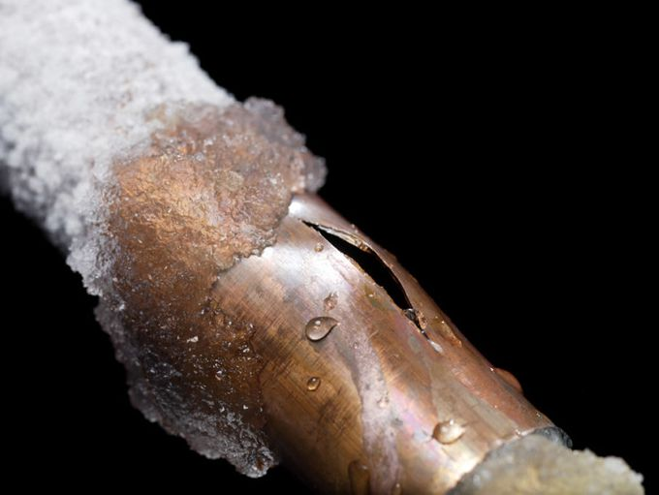


Notes:
So what are trips and what causes them? We learnt that frequently, it occurs when the water inside them expands is it gets close to freezing,often during downtime when the chiller is not being actively used. This causes an increase in pressure inside the pipe. When the pressure gets too high for the pipe to contain, it ruptures. As you can imaginee this severly affects the chillers performance and can cause the entire system to gradually breakdown.

Slide 8
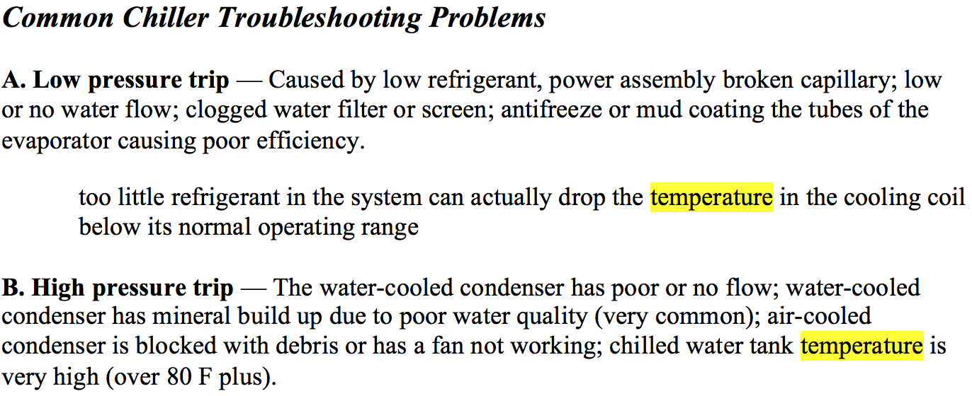
According to our consults with the Subject Matter Expert and secondary research:
Notes:
This was in line with our further secondary research that many a time trips are cause by temperature related factors, or otherwise serve as a good indicatior

Slide 9
Process
Understanding the errors
Feature Selection & Creation
Building our Neural Network
Notes:
So this leads to our overall general methodology. The first step was to seek to understand the errors, what causes them, how to recognise them, exploring the data. The next step would then be to select features , modify them or create them altogether, Subsequently, we then feed them into our neural network, and finetune it.

Slide 10
2.
Understanding the Data
Identifying Patterns in our Data
Notes:
Before building the model, to get a proper sense of the relationship between the various measurements and trip error, we performed data visualisation

Slide 11

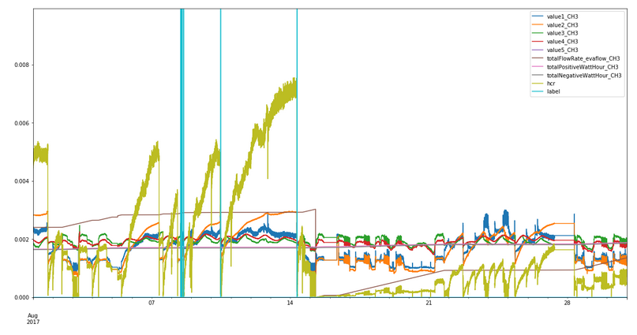
Want big impact?
Use big image.
A pattern occurs before an Error!
Notes:
Data visualised were for measurements that were indicated as potentially important as informed by domain knowledge.
These included measurements like temperature, flow rates, power and calculated metrics like Heat Capacity Rate.
In this graph, we look at temperature. interestingly, there is a relationship between HCR and the trip error. Prior to the occurences of the trip errors, HCR tends to rise sharply, with prominent fluctuations as seen from the ‘scratchiness’ of the line.

Slide 12
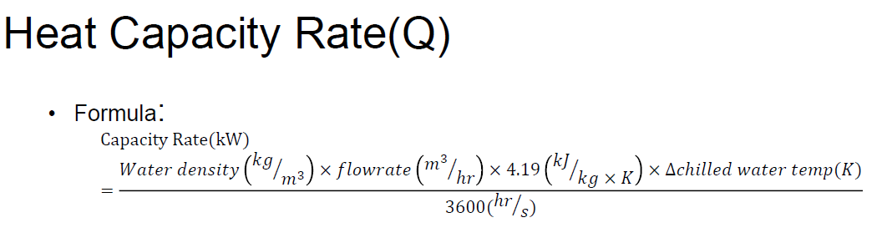
HCR describes the quantity of heat release and absorbance of a flowing liquid per unit temperature change per unit time
HCR is a useful indication of the effectiveness / efficiency of the coolants in the system.
Notes:
This is the formula for HCR, as in this metrics, we capture information regarding the temperature.

Slide 13
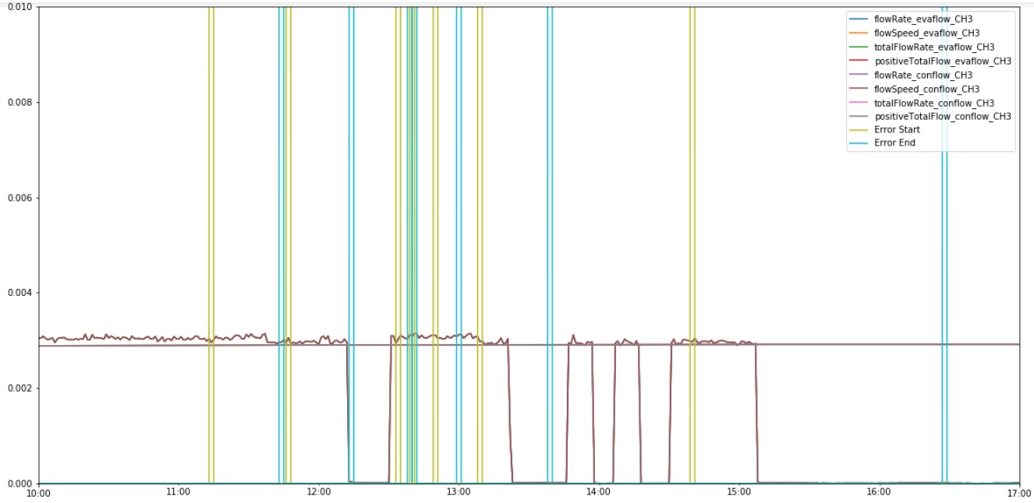
Examining other variables, condenser/evaporator flow rate does not seem to have an important relationship with errors
Notes:
Moving on to flow rates. Other variables such as conflow and evaflow do not suggest any important relationship with the occurrences of errors.

Slide 14
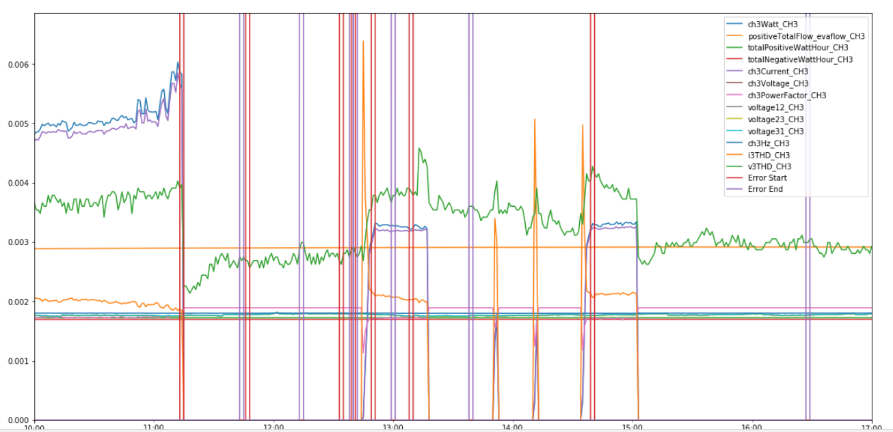
The other power variables turn out to be less promising as well
Notes:
This is true for power variables as well.Some may show some differences prior to an error but not to as distinct or consistent as hcr.

Slide 15
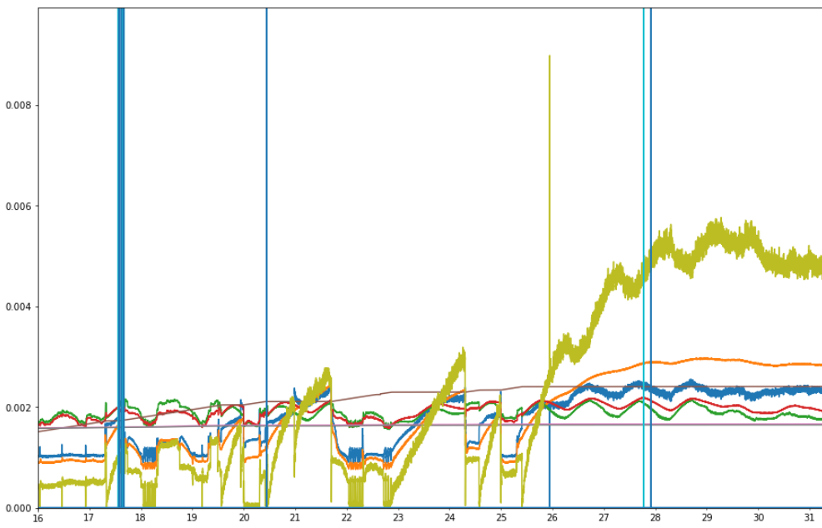
HCR can still help to indicate non-trip errors too. Less strong but can distinguish errors
Notes:
We tested this relationships with other kinds of non-trip error. Example used here is Chiller 4, August, Compressor 1 Status Revert.
As expected, different errors have different origins. Thus different sets of measurements are need to predict each error. So while HCR is pretty useful for trip error, not so for compressor status revert error.
Naturally since the compressor status revert error might not caused solely by temperature. Many still have temperature related nonetheless.

Slide 16
3.
Prepare
Cleaning and Transforming our Data
Notes:
After data visualisation, we then prepare the data.
Data preparation includes 3 steps.
1)Data Windowing
2)Data Transformation
3)Data Scaling

Slide 17
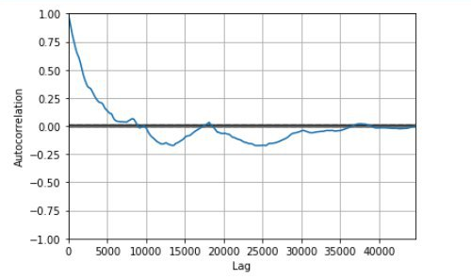
Step 1: Windowing
Determine Window Size Through Autocorrelation
Autocorrelation determines
a good estimate for
Window Size
Notes:
The first step: Windowing.
By creating a window, we are able to collect information from a span of time rather than individual points.
Which is useful for time-series data.
Rather than naive windowing, we used autocorrelation to identify optimal window sizes.
This is especially useful since when building the model in the later steps,
we use historical measurements of HCR to predict future HCR.
This value was estimated where autocorrelation is above 0.5.

Slide 18


Step 2: Data Transformations
Slope
The gradient of the line plotted by the window
Sigma
The standard deviation of the HCR values within the window
Max
The largest HCR value within the window
Mean
The average HCR value
Notes:
From the windows created in the first step, we then perform transformations to HCR.
Taking values across the window and obtaining a statistic.
These statistics are as shown on screen.
These transformation were selected due to the observations of the HCR pattern. Where HCR showed as steep increase with large fluctuations prior to a trip

Slide 19
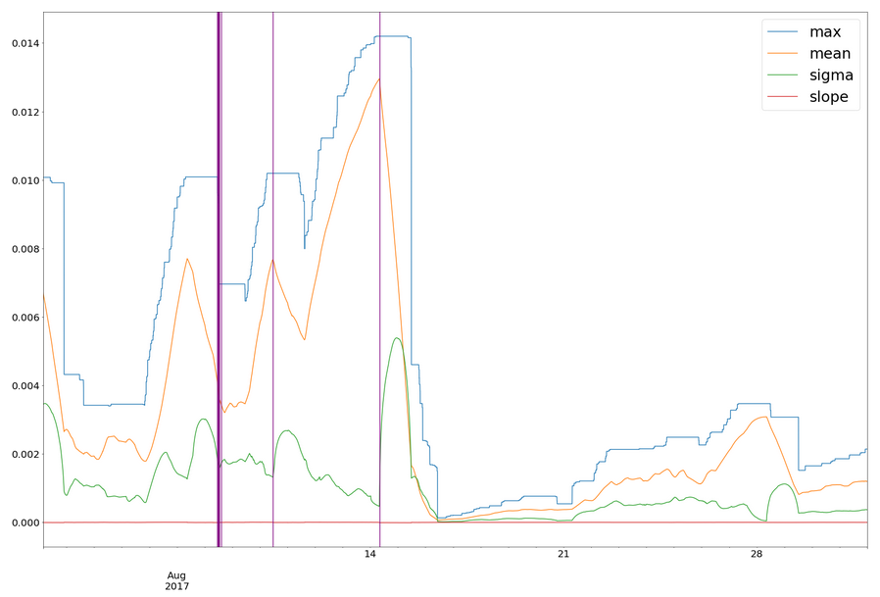
Visualisation of
Mean, Max, Sigma, Slope
Use big image.
Notes:
From the graph, we identified a clear and more distinct relationship between HCR and the error occurrences.
This is especially true for HCR mean, which forms a peak prior to an error occurrence.

Slide 20
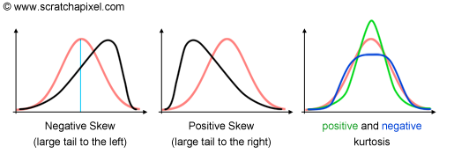
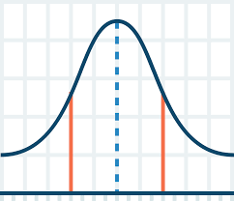
Step 2: More Data Transformations
Variance:
Moment 2
Measure the spread of value from their average value
Skewness:
Moment 3
Measure of the lopsidedness of the distribution
Kurtosis:
Moment 4
Measure of the heaviness of the tail of the distribution
Notes:
We experimented with different moments as well to see if statistics used to quantify the shape of the graph share a relationship with error.

Slide 21
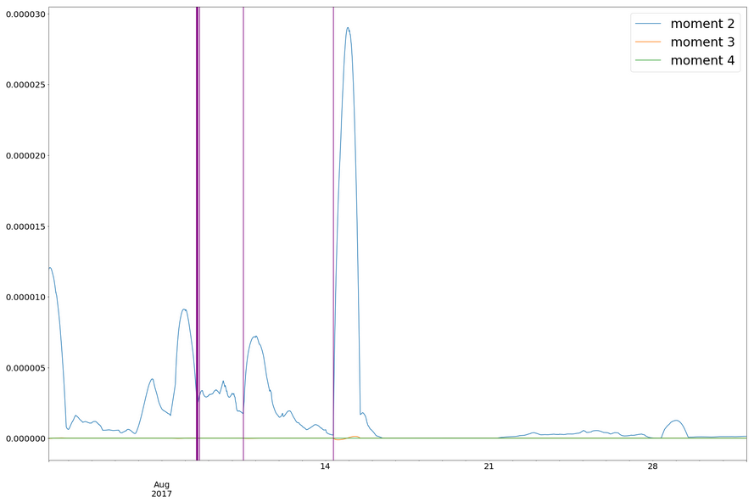
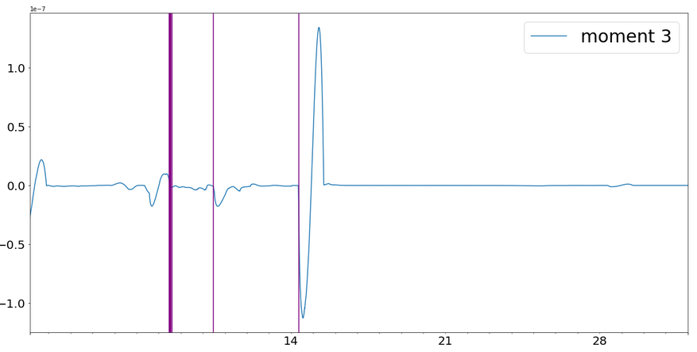
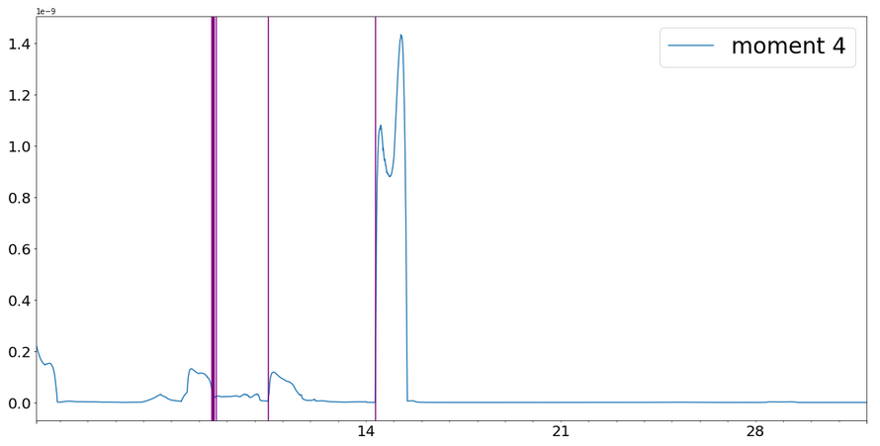
Visualisation of
Variance, Skewness, Kurtosis
Use big image.
Moment 3
Moment 2
Moment 4
Notes:
Variance behaves similarly to sigma as the data is squared. Forming peaks though the occurrence of the peaks is inconsistent with respect the the occurrence of the trips.
There is no apparent pattern with skewness and kurtosis and the occurrences of error

Slide 22
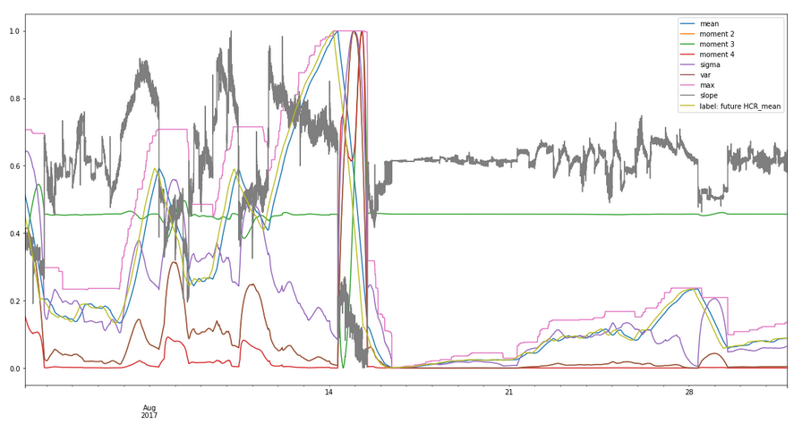
Use big image.
Step 3: Data Scaling
Values are scaled between 0 and 1
Notes:
Finally, in step 3, we perform min-max scaling such that all measurements are between 0 and 1.
This ensure that the model can be
1) train properly as each value is weighed equally and
2) converge efficiently.
With this, we now have a clear idea of the relationships of the measurements. The data is can now be used to build the model.

Slide 23
4.
Build
Creating the Best Model
Notes:
Using the set of processed data shown in the previous slide, we set out to build our model.

Slide 24
We had 2 Ideas for our Labels
?
Minutes to Error
HCR as Proxy
Notes:
Initially, we had 2 ideas for our label column:
The first idea was to predict the number of minutes to the next error. This idea is most-straightforward as it answers the our business question directly.
The second idea was to predict the value of a proxy, and use this proxy to determine if an error is going to occur.

Slide 25
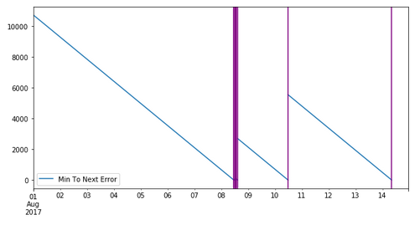
Minute to Error
Create a label which indicates the duration to the next error
Notes:
For the first idea, we created a label column in our dataframe which indicates the number of minutes to the next error.
Looking at the diagram, blue lines represent number of minutes to next error while purple lines represent error.

Slide 26
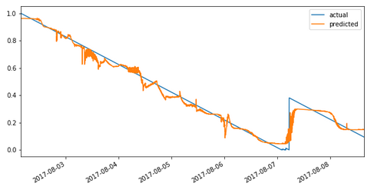
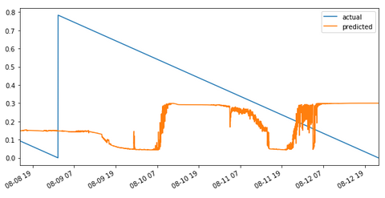
Visualizing Prediction
Use big image.
Training Set
Test Set
Notes:
Upon training our model, the following results were obtained.
The figure above is the training set while the one below is the test set. Blue lines represent actual minutes to next error, while orange lines are predicted values.
As can be seen overfitting has occurred as the model predicted poorly for the test set.
Therefore, we decided to explore other options for our label data.
This brings me to our second idea, which is to predict values of a proxy, and use that proxy to determine if an error is going to occur.
------------------
Furthermore, our team felt that predicting minutes to next error may not be a good idea, due to a lack of pattern. Prior to each error, the blue line will always be a downward sloping curve with a constant gradient. In other words, no matter how our predictors change, the

Slide 27
Want big impact?
Use big image.
HCR is a potentially good proxy for error
Notes:
From our earlier data visualizations, we noticed that HCR is potentially a good proxy for error.

Slide 28
HCR as Proxy
1) Using HCR Statistics to predict future HCR [horizon: 4 hours]
2) Use predicted HCR to determine error occurrence
Notes:
Thus, our second idea involves 2 steps:
Predict future HCR values using historical HCR statistics (mean, sigma, gradient, moment 2, 3, 4) (horizon: 4 hours)
Using the predicted HCR values, we can determine if an error is going to occur

Slide 29
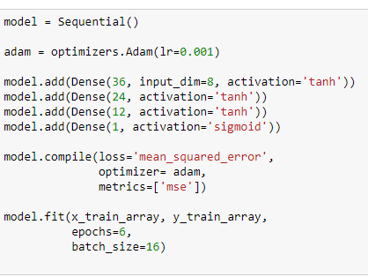
The Model
Notes:
APPROACH:
1) Iterate through learning rate
2) Incrementally include hidden layers
Final Model (after optimization):
FFNN (using Keras)
2 hidden layers
TanH activations other than the last one which uses sigmoid

Slide 30
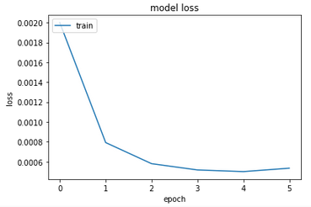
Loss Graph
Signs that the model is properly trained

Slide 31
5.
Result
Verifying our Predictions based on HCR Proxy Label

Slide 32
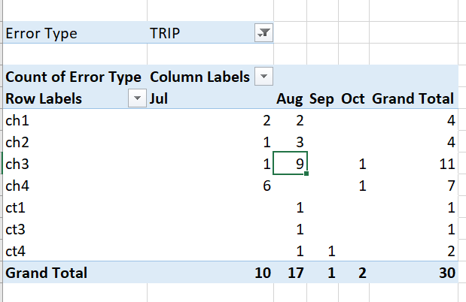
Notes:
For the purpose of a proof-of-concept, our team decided to focus our analysis on 1 chiller for 1 month.
This reduces unnecessary complexities such as variation across chillers, and seasonal weather variations in different months.
From our pivot table, we notice that most trip errors occur in chiller 3, in the month of aug.

Slide 33
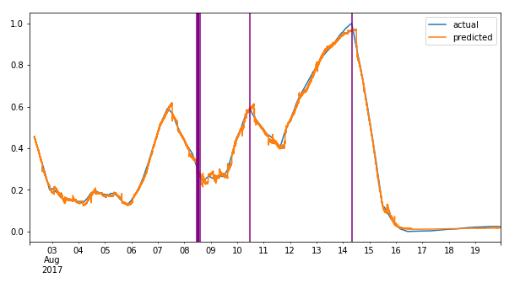
Training Set
Use big image.
Notes:
Upon training our model, the following results are obtained. This graph shows the training set, where the orange line are predicted values, while blue line is the actual value.
As can be seen, the predicted values are pretty accurate.

Slide 34
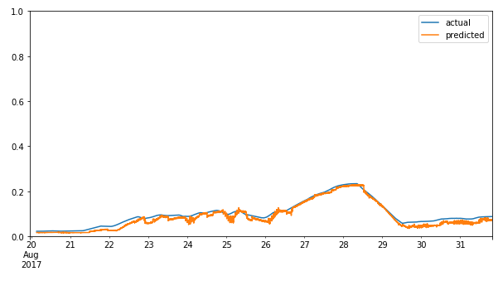
Test Set
Lag: ~2 hours
Horizon: 4 hours
Notes:
This is again seen in the test set, which shows that our model was not over-fitted to the training values.
On average, our predicted values are lagging at about 2 hours
Recall that our horizon is 4 hours, meaning that our model is capable of predicting 2 hours in the future.

Slide 35
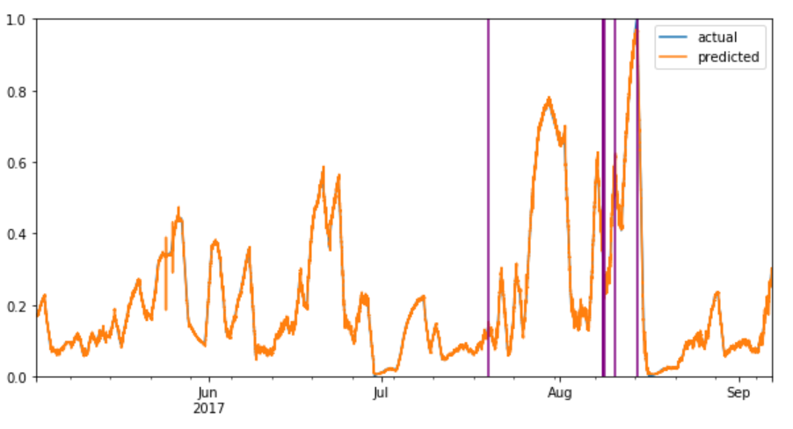
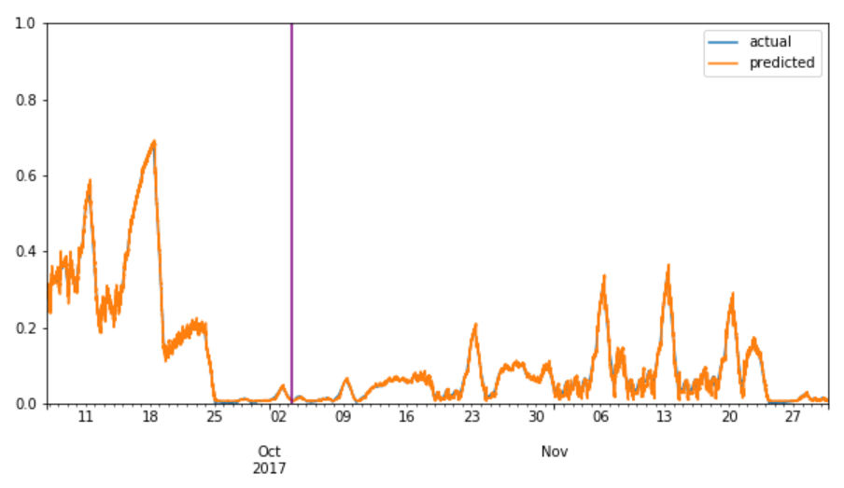
Training Set
Chiller 3
Test Set

Slide 36
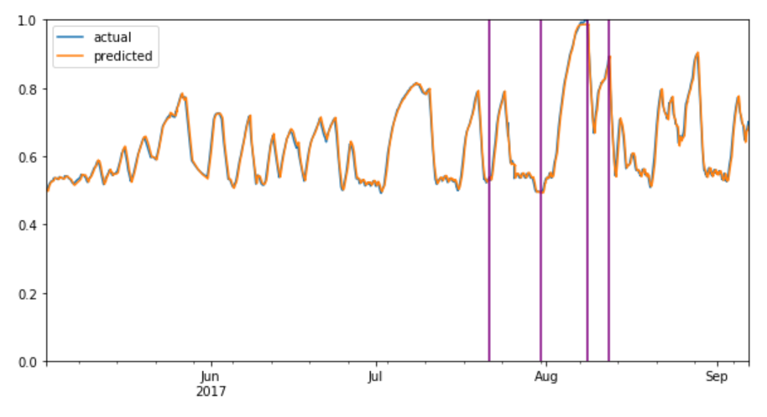
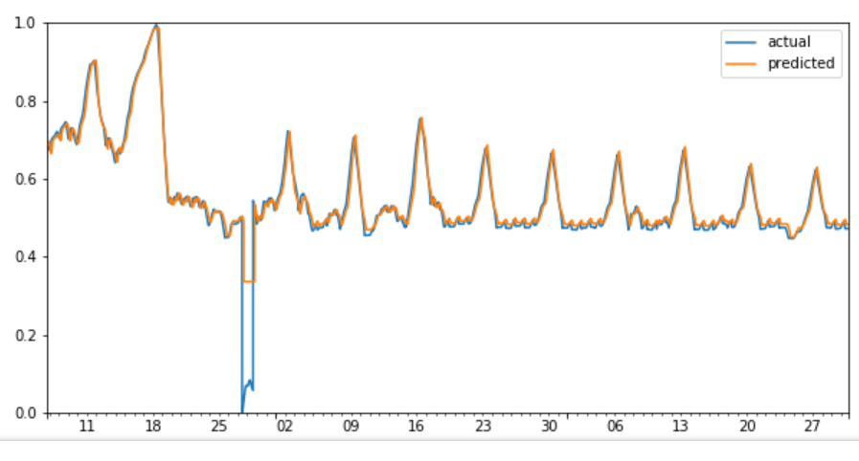
Training Set
Chiller 1
Test Set
Notes:
Our prediction further performed well across the other 3 chillers.

Slide 37
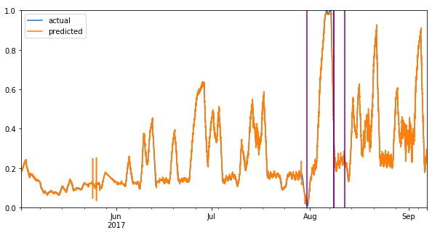
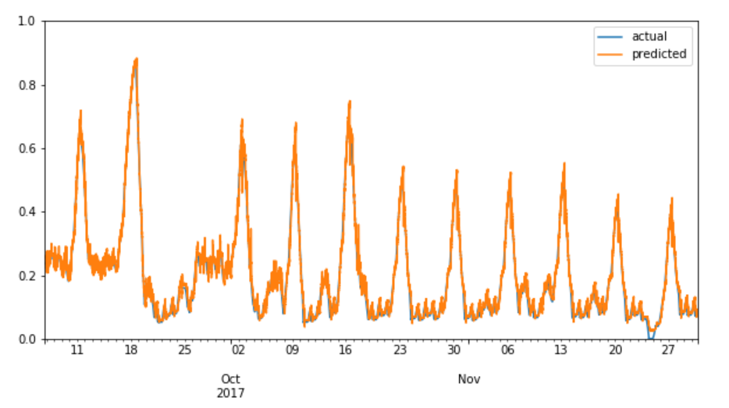
Training Set
Chiller 2
Test Set

Slide 38
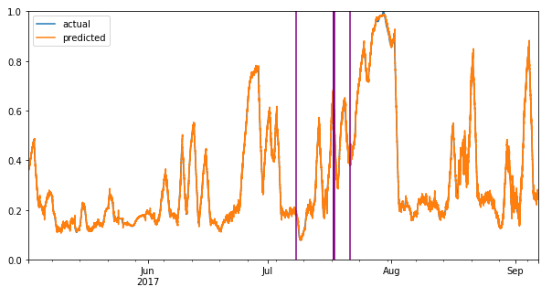
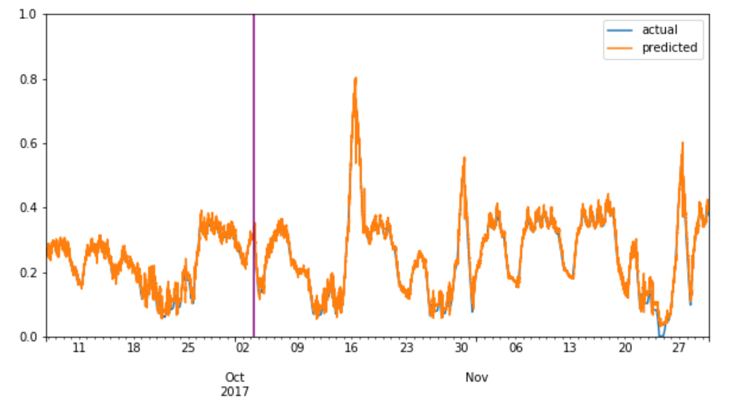
Training Set
Chiller 4
Test Set

Slide 39
Determining Error Occurrences
Use big image.
Probabilistic Classifier
Function that takes in:
Mean HCR
Gradient of HCR
Variance of HCR
P
Notes:
Using the predicted HCR values, we will use a probabilistic classifier to find probabilities of trip error occurrence.
For instance, this could be a function that maps the mean, gradient, and variance of HCR to output probability of trip error occurrence. This is similar to the use of Naive-Bayes, or Decision Tree algorithms.
We

Slide 40
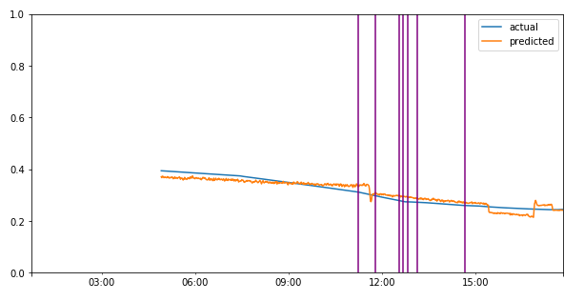
Training Set
(zoomed in to errors in 2018/08/08)

Slide 41
6.
Potential Applications
Translating Technology Solutions into Business Value
Notes:
So now then we know what it can do, here is how we propose to implement the solution in terms of user experience

Slide 42
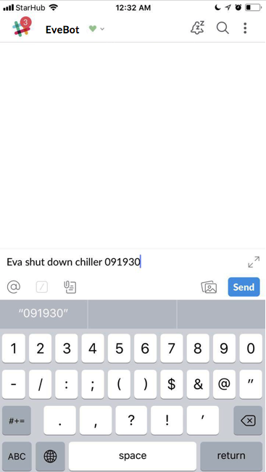
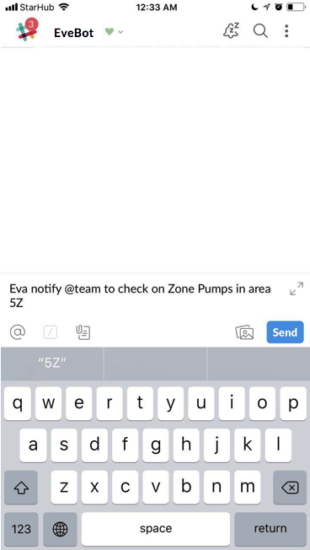
Resolving issues on-the-go
Our predictive model can easily integrate into Evercomm’s existing platform by serving as an AI bot
Notes:
Our predictive model can easily integrate into Evercomm’s existing platform by serving as an AI bot, allowin for convenient , even passive yet effective monitoring, anytime anywhere

Slide 43
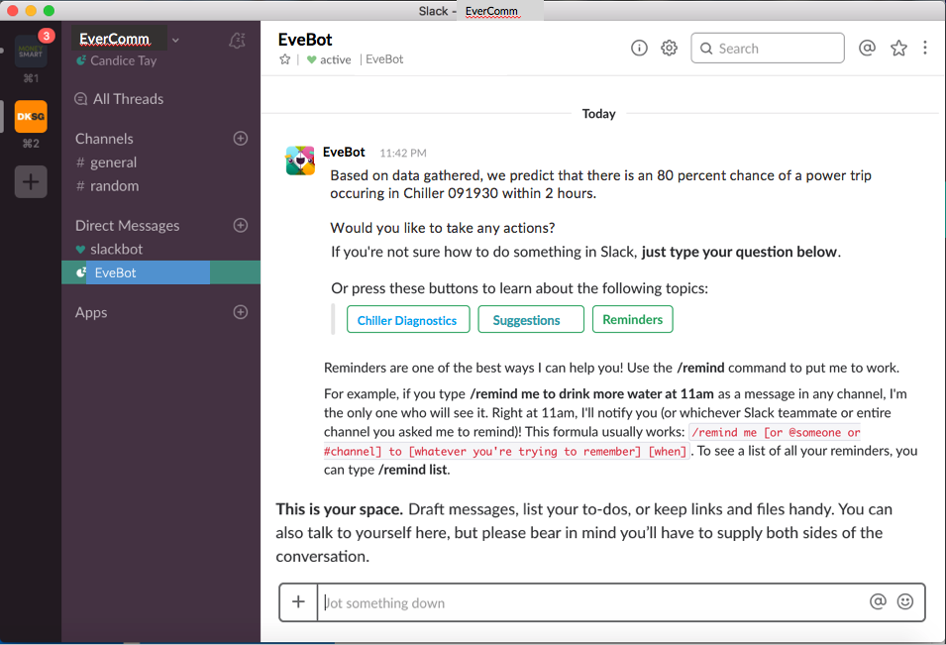
Desktop Updates
Place your screenshot here
Eva could use our predictive model to send notifications to service technicians on usual behaviour in the system
Notes:
This would also be available on computers, and Upon being alerted a greater level of information can be accessed in the computer. It can be integrated with other platforms such as cameras for instance, and allow easy communciation with other stakeholders through slack such as in terms of action plans and updates. The Slack platform would allow easy management and access to the analytics provided from our platform in easy to understand dashboards.

Slide 44
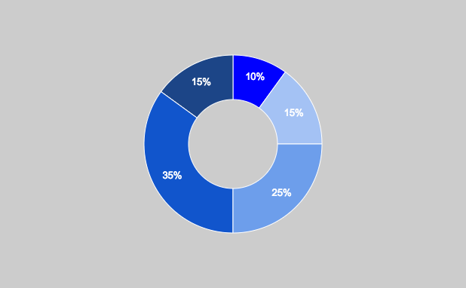
Chiller Analytics Dashboard
Probability of Different Error Types
Estimated Time of Error:
09:23 AM
Urgency: Level 2
Recommended Actions:
Investigate Pump Circulation
Chiller 1
Chiller 2
Chiller 3
Chiller 4
Mean HCR
Chiller Power(in Watts)
Mean Flow Rate
Back
Status Log
44

Slide 45





+ Added Functionalities on Slack
Probability of Error
Estimated time to error
Type of Error
Suggested course of action

Slide 46
Thank You!
Any Questions?

Slide 47
Credits
Special thanks to all the people who made and released these awesome resources for free:
Presentation template by SlidesCarnival
Photographs by Unsplash

